Slide 1

ВЕШТАЧКАТА ВЕШТАЧКАТА И ДЕЛОВНА ИНТЕЛЕГЕНЦИЈА И АКАДЕМСКИТЕ ИСТРАЖУВАЊА - ПРАКТИЧНИ АСПЕКТИИ
29.03.2023
Dushko Todevski
https://www.linkedin.com/in/dushko-todevski-9357405/
duskotodevski@gmail.com
+38975405305

Slide 2
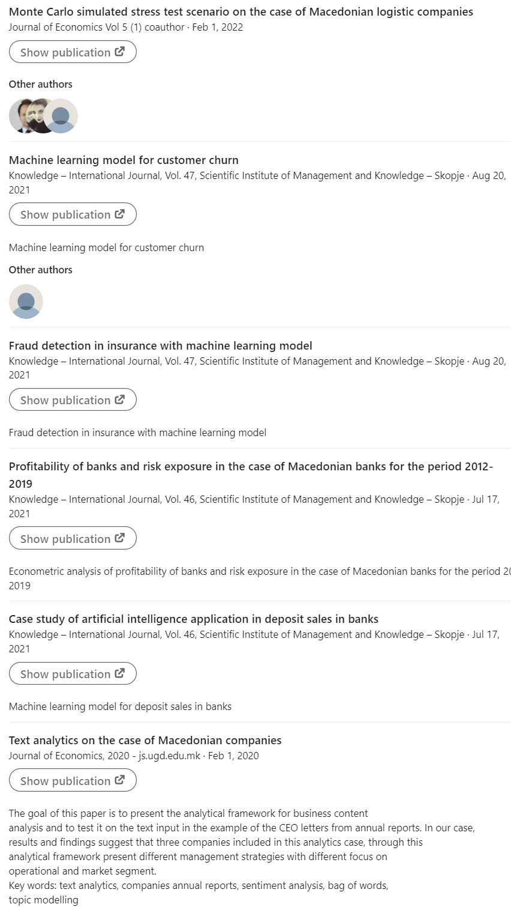
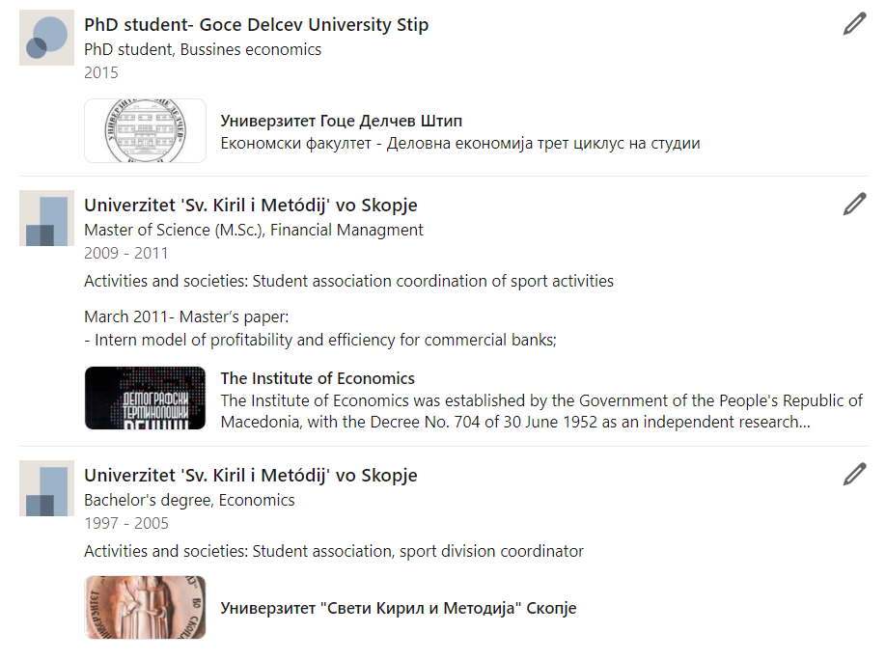
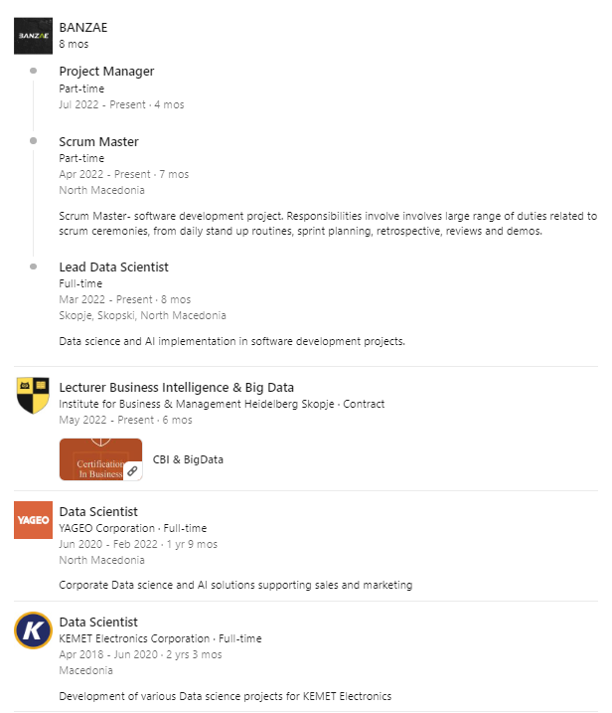
Dushko Todevski

Slide 3
ЦЕЛИ
Практични аспекти на вештачка и деловна интелигенција со Orange3
1. Практични аспекти на вештачка и деловна интелигенција со PoweBI

Slide 4

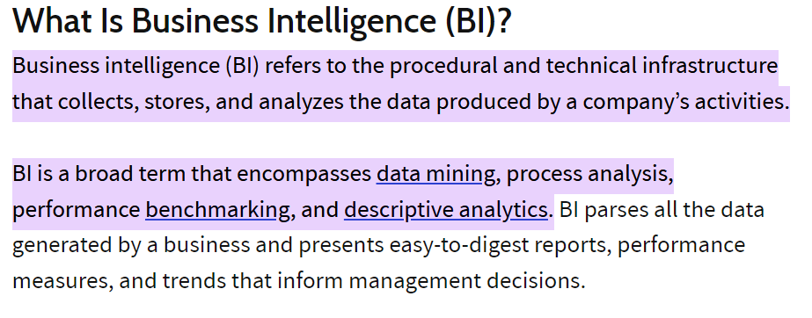
Што е деловна интелигенција?

Slide 5

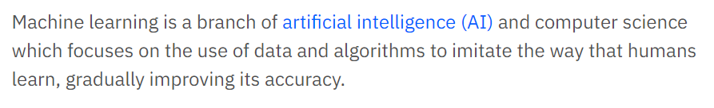
Што е машинско учење?

Slide 6
цитати
“Maybe stories are just data with a soul.”
— Brené Brown
“The goal is to turn data into information, and information into insight.”
— Carly Fiorina
“Data are becoming the new raw material of business.”
— Craig Mundie

Slide 7
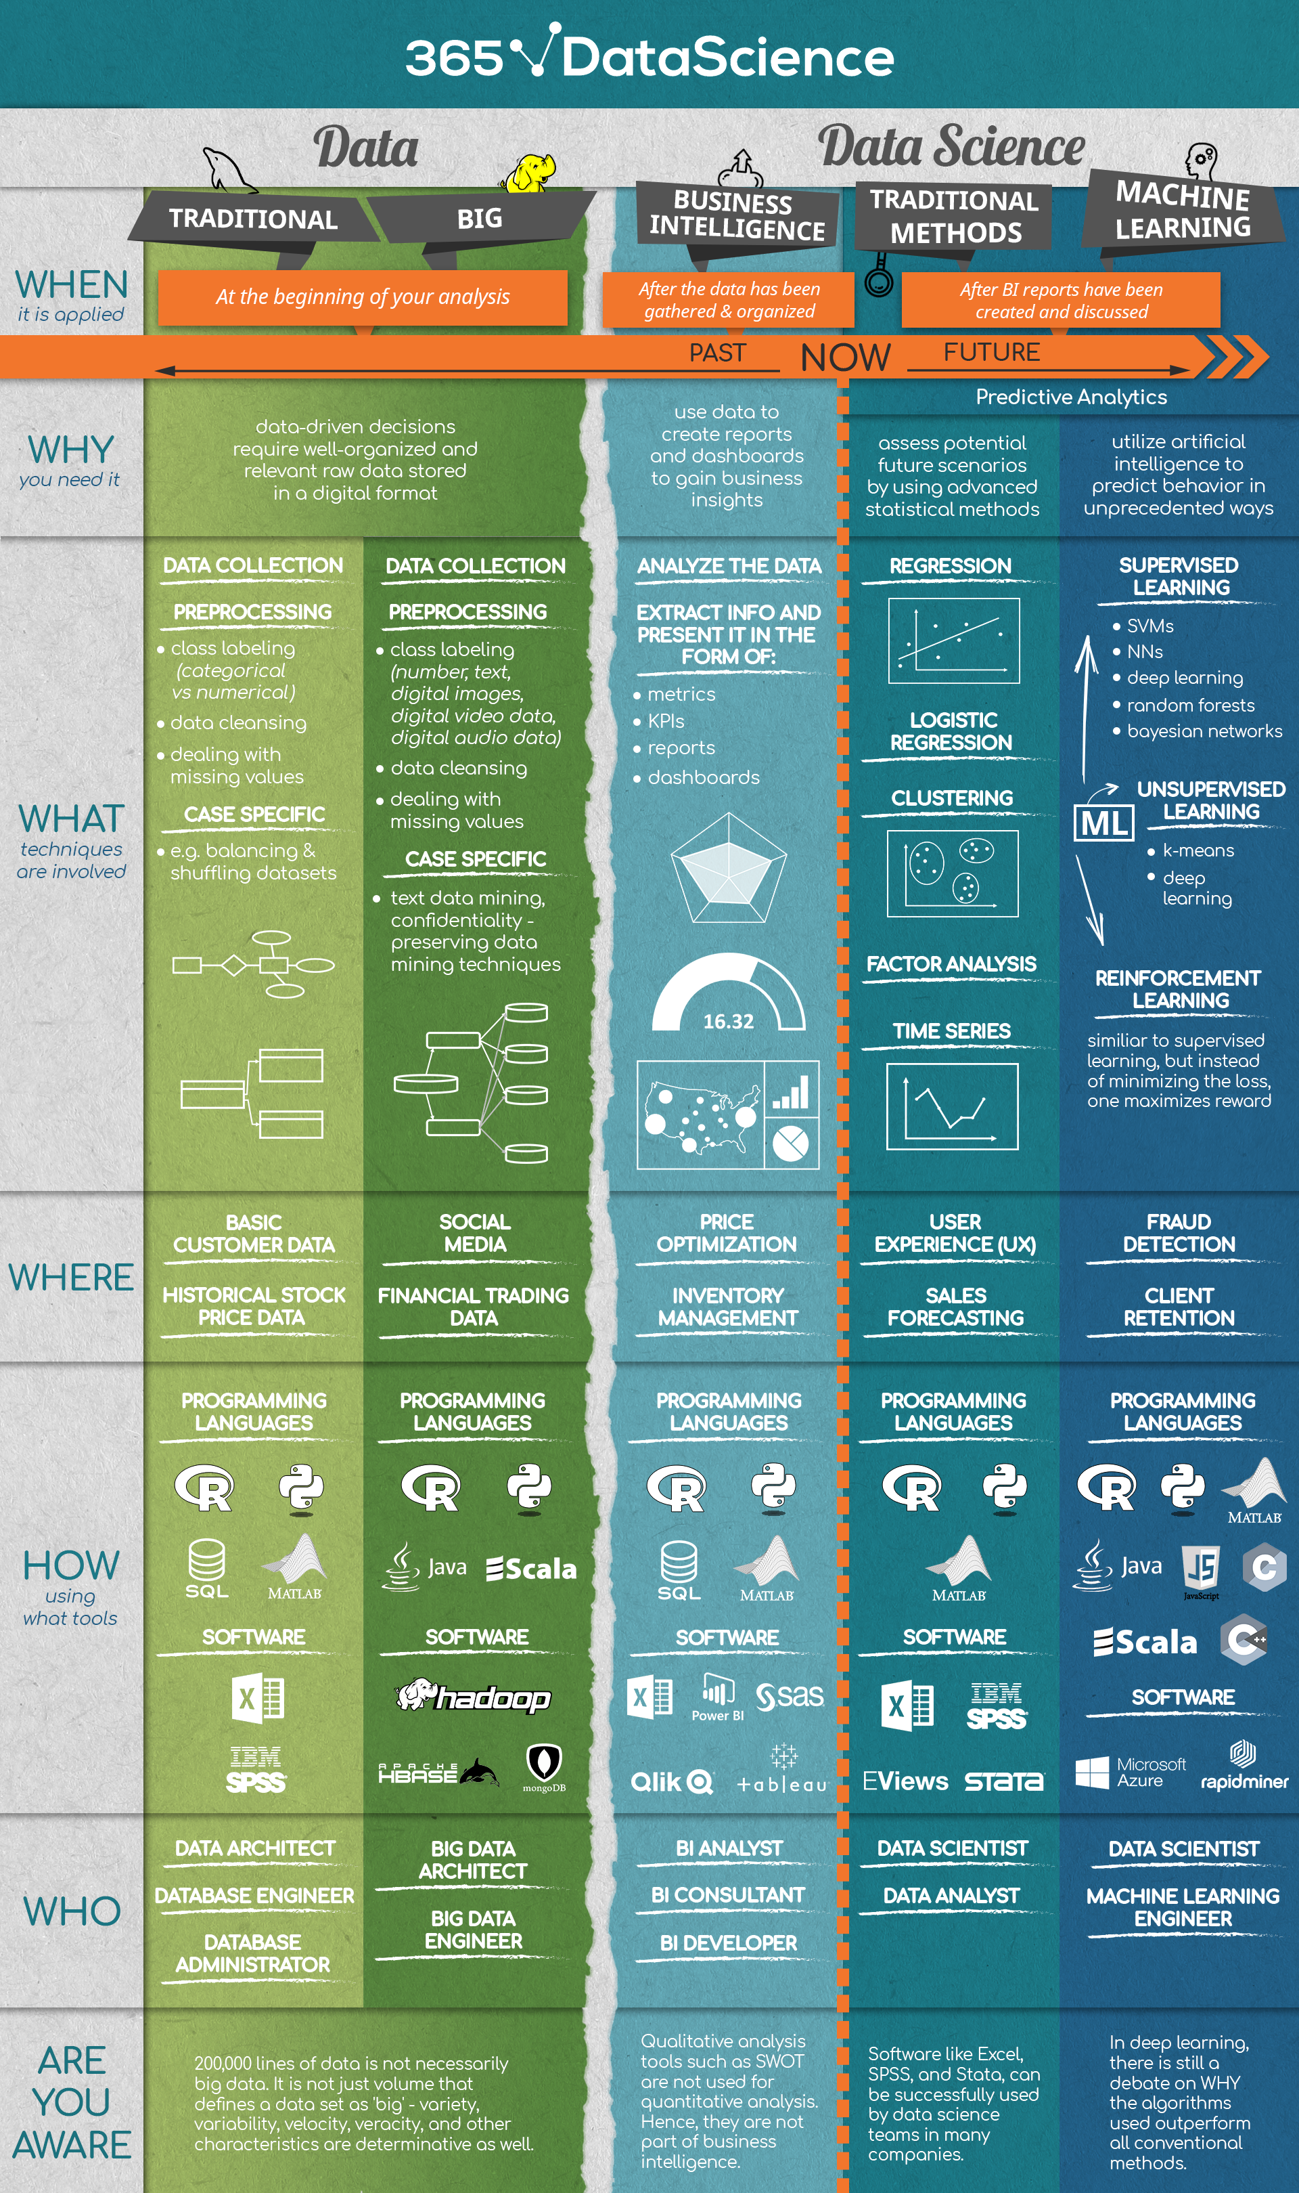
перспективи

Slide 8
Power BI and orange
Download Power BI
https://powerbi.microsoft.com/en-au/desktop/
Why Power BI?
Docs https://docs.microsoft.com/en-au/power-bi/
Download Orange
https://orangedatamining.com/download/#windows
Why orange
Docs https://orangedatamining.com/docs/

Slide 9
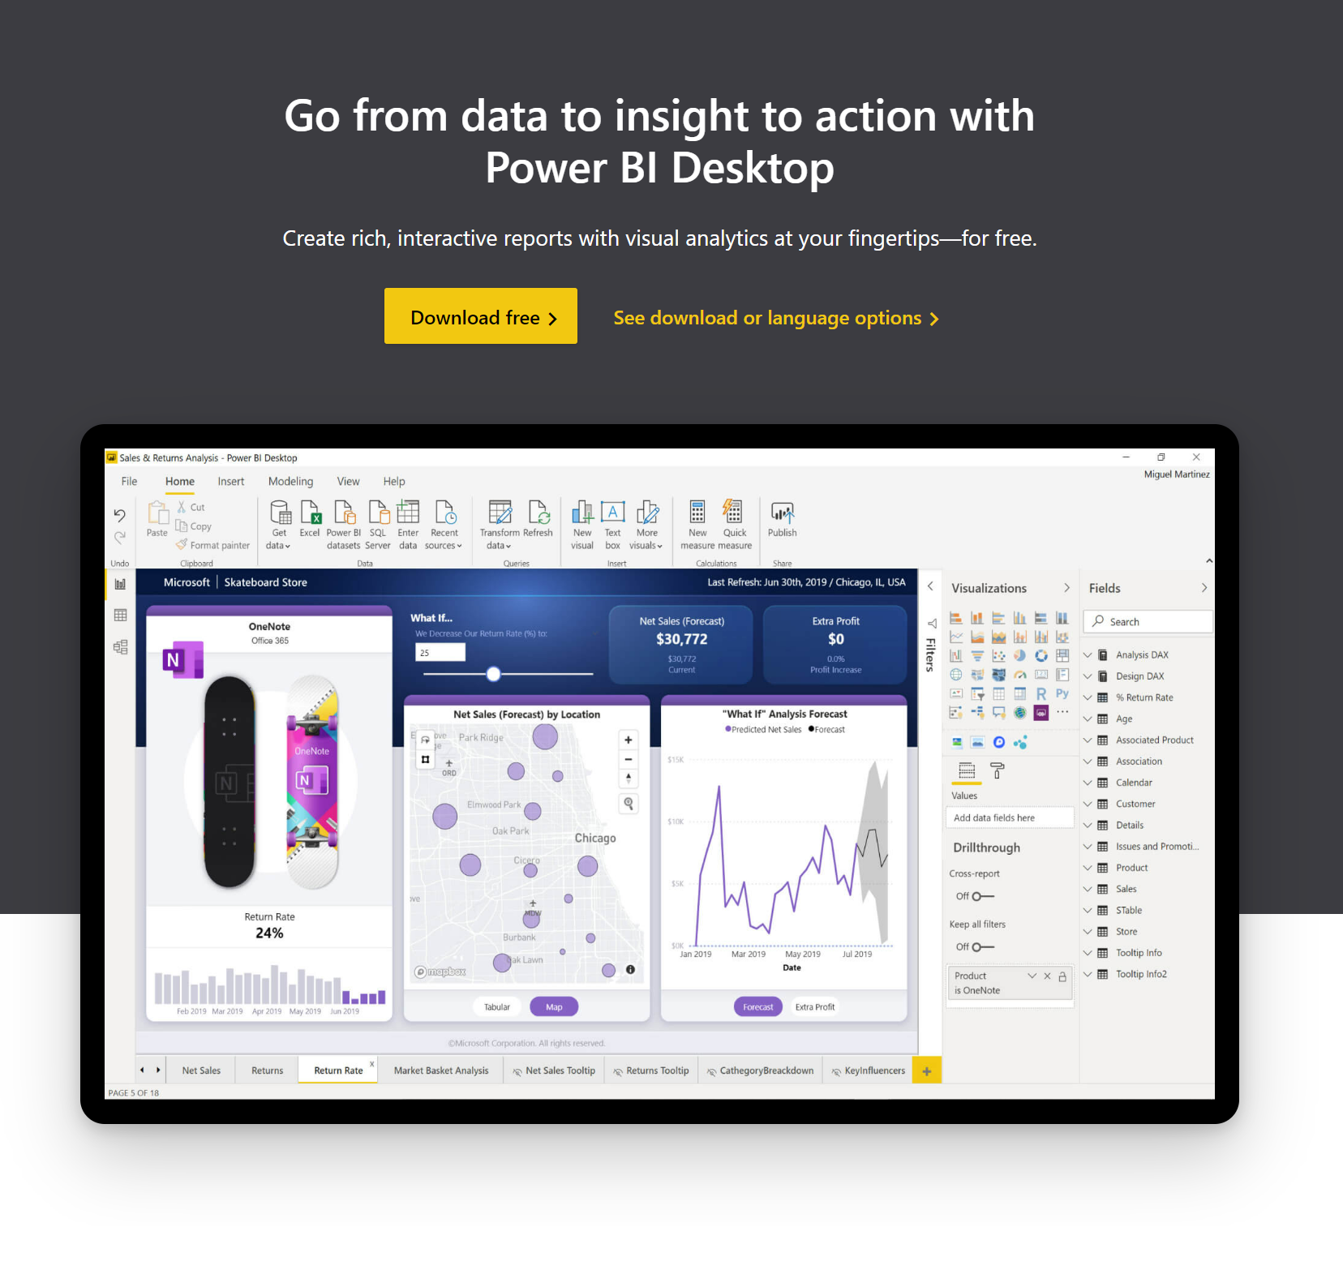
POWER bi
https://powerbi.microsoft.com/en-au/desktop/

Slide 10
POWER bi
Connect to and visualize any data using the unified, scalable platform for self-service and enterprise business intelligence (BI) that’s easy to use and helps you gain deeper data insight.
Bridge the gap between data and decision making
Create amazing data experiences
Gain insight from your largest BI deployments
Make decisions with confidence

Slide 11
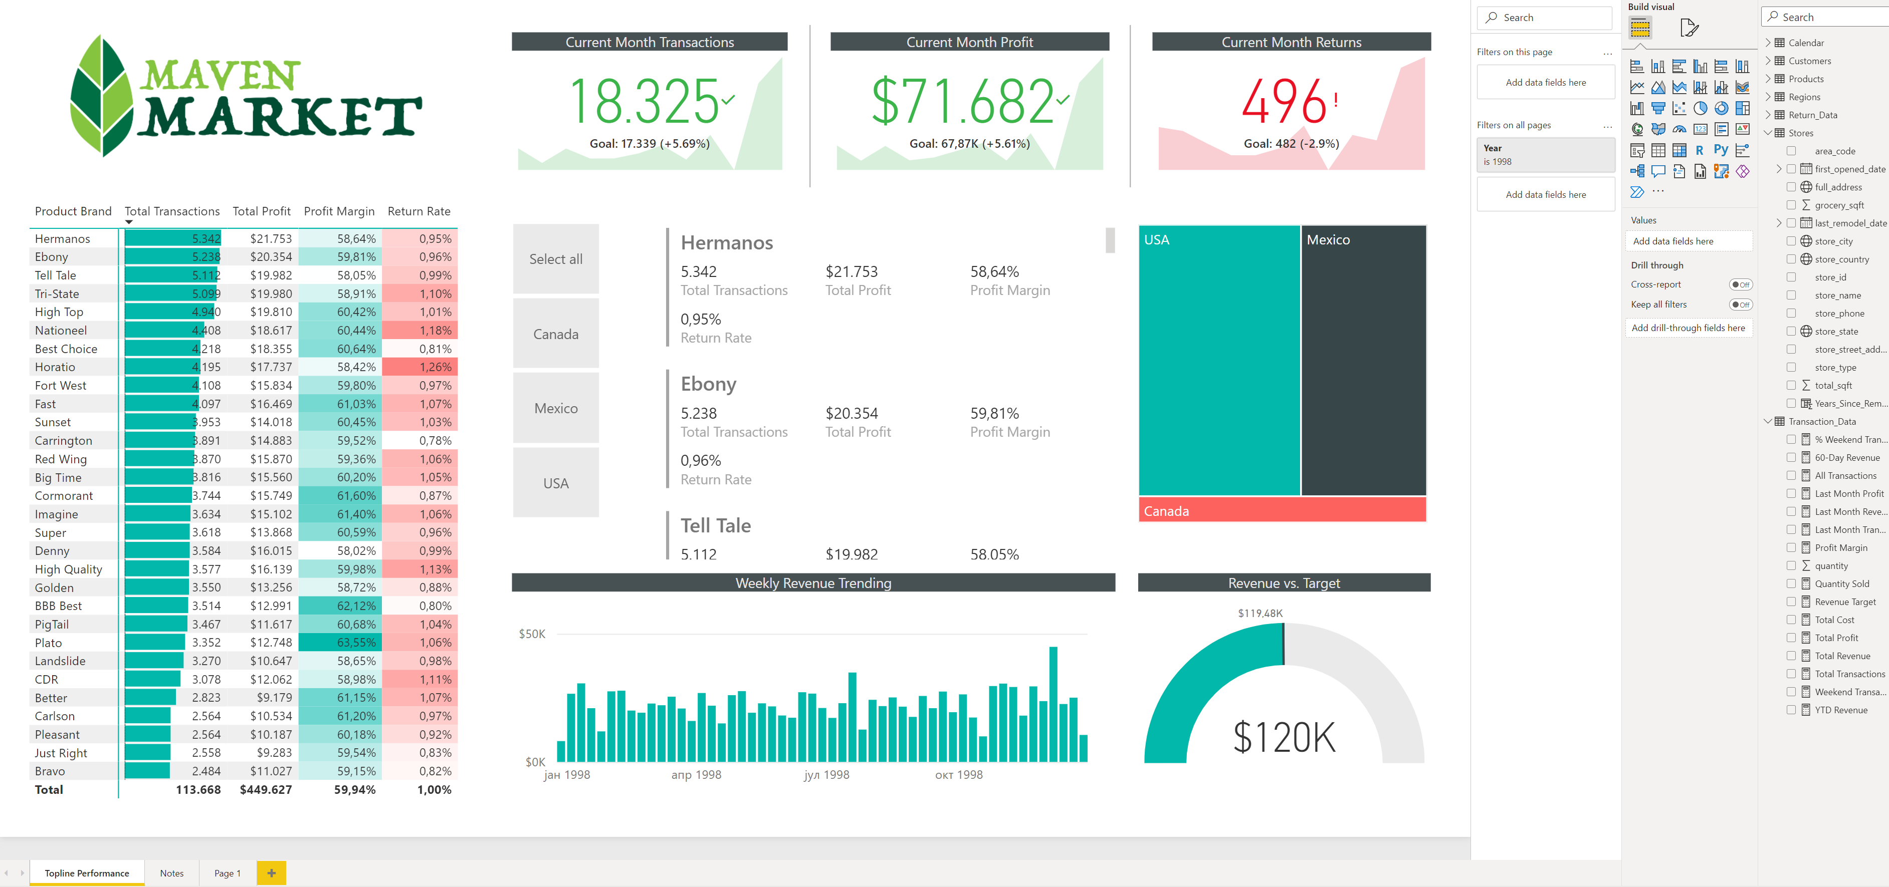
POWER bi
HANDS ON

Slide 12
Прашања и одговори

Slide 13
БЛАГОДАРАМ НА ВНИМАНИЕТО

